Slide 1
GPU accelerated Localization and Mapping (SLAM)
University of Pennsylvania
CIS 565 – Final Project
Final Project Presentation
Nischal K N

Slide 2

SLAM
SLAM – Simultaneous localization and Mapping
Solve two problems at once
Find out where you are in the current map
Update the map with what new information you know about it

Slide 3
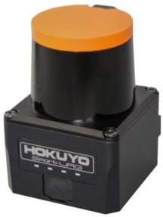
Data Source - LiDAR
Step k+1
Step k
Angular resolution 0.25 degrees
Hokuyo UST-10LX
270 degrees horizontal field of view
Step 1079
Range
10m
Step 1
Step 0

Slide 4

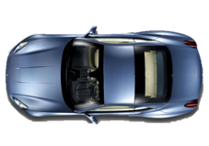

Scan 1
A₁
x
Car reference
frame
x
y
World reference
frame
y

Slide 5
Scan 2
x
y
World reference
frame

Slide 6
Scan 2
x
y
World reference
frame

Slide 7
Scan 2
x
y
World reference
frame

Slide 8
Scan 2
x
y
World reference
frame

Slide 9
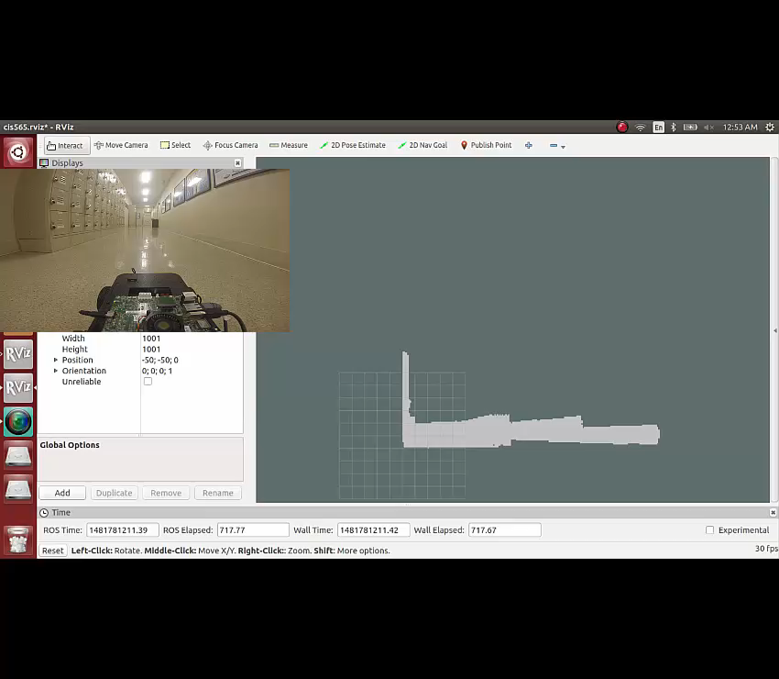
Demo

Slide 10
Operation on CPU vs GPU

Slide 11
Execution Time vs Particles

Slide 12
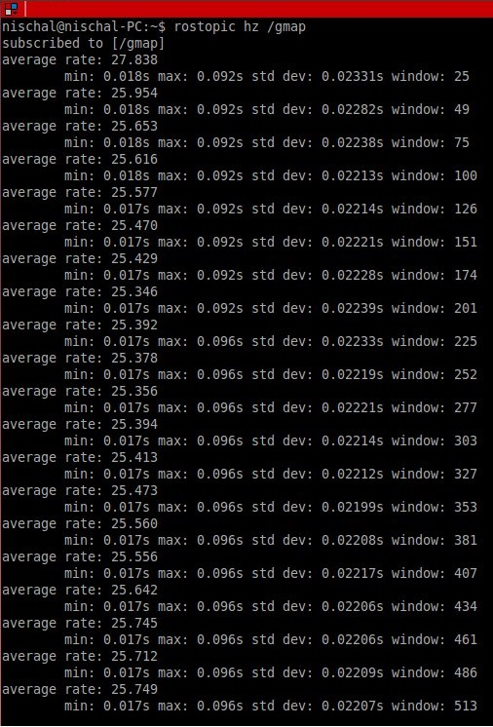
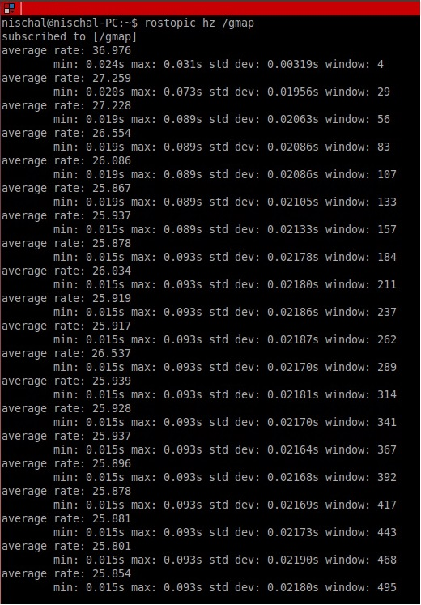
Performance Comparison
With cudaMemCpy
Zero copy access
Update Rate: 25.231 Hz
Update Rate: 26.012 Hz

Slide 13
Operating Frequency
CPU
GPU
2320500 kHz
2014500 kHz
1734000 kHz
1428000 kHz
1122000 kHz
852000 kHz
708000 kHz
612000 kHz
396000 kHz
180000 kHz
Three kernels evaluated
Particle generation and scan orientation
Calculation of Correlation Scores
Copy of Local Map to Global Map

Slide 14
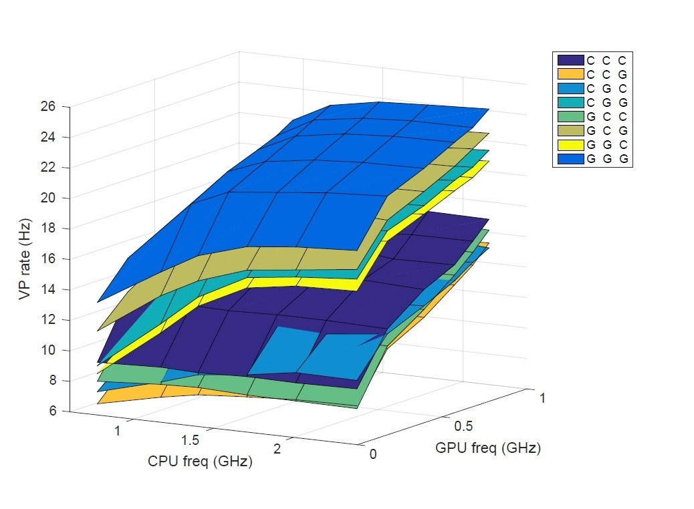
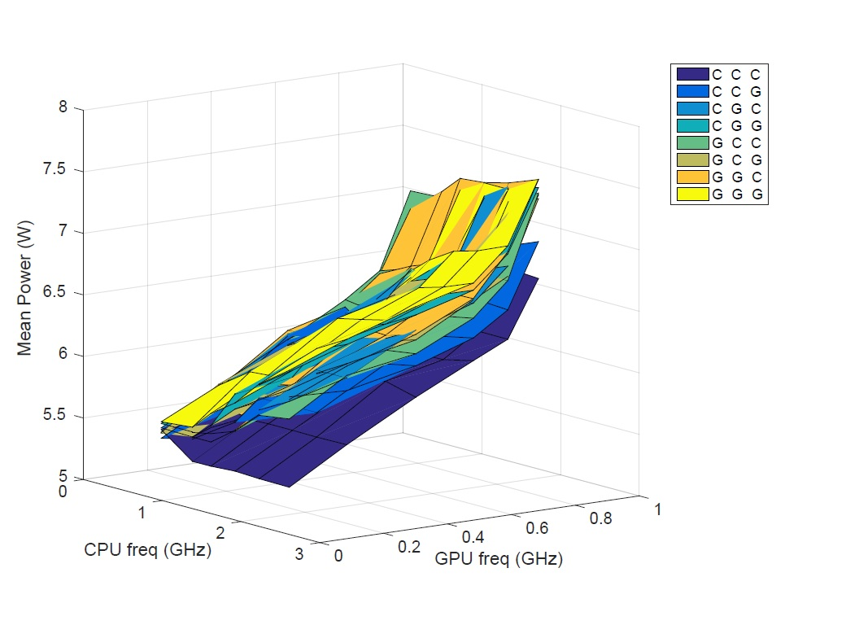
Operating Frequency

Slide 15
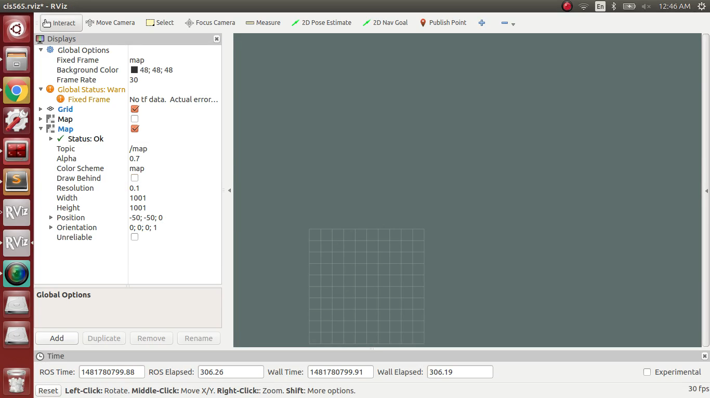
Limitation – High Particle Count

